Slide 1
The Heart

Slide 2
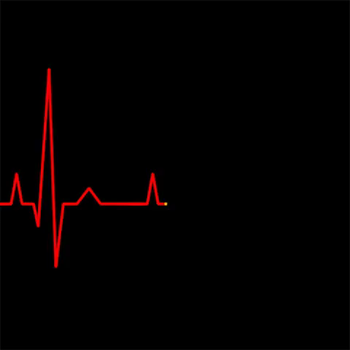
By the end of this Smart Lesson you should be able to:
1. | State the function of the heart.
2. | Describe and identify the structures of the heart.
3. | Describe the blood circulation pathway within the body.

Slide 3
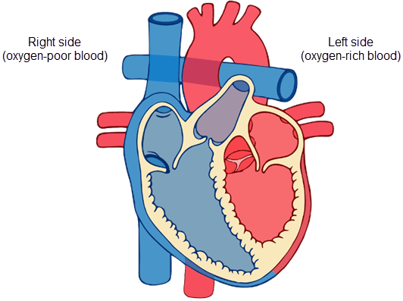
The heart is the motor of the circulatory system.
The heart muscle contracts and pumps deoxygenated blood (low in oxygen from cell usage) directly into the lungs where it becomes oxygenated (oxygen-rich), before returning to the heart to be transported throughout the body.

Slide 4
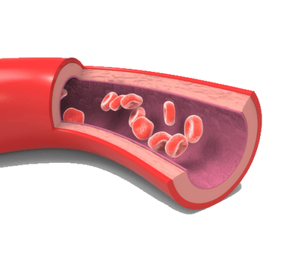
Without the heart, our blood would be immobile and the cells in our body wouldn't be able to get enough oxygen and nutrients to survive.
The heart is the driving force of the entire circulatory system.

Slide 5
The heart is a muscle which acts as a pump.
It is approximately the size of your fist and is located slightly to the left of the middle of your chest.

Slide 6
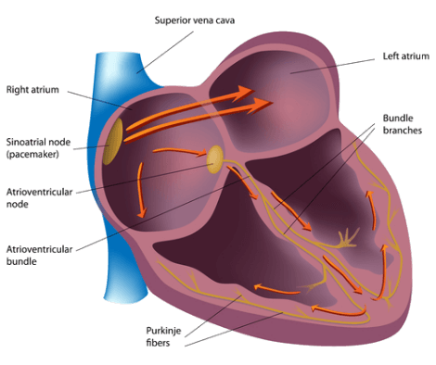
Have you noticed you don't have to make your heart beat?
The heart beats without having to be told to. This is because the heart has a natural pacemaker, called the sinoatrial node.
This controls heart rate by sending electrical signals through the heart muscle, making the heart contract and pump blood throughout the body.

Slide 7
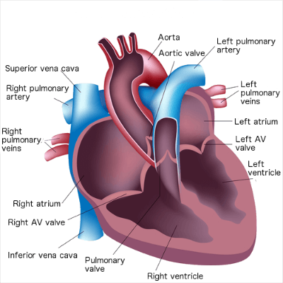
The heart consists of four different chambers along with the blood vessels entering and leaving the heart.
The figure below shows the structure of the heart. Note how there are two atriums and two valves.

Slide 8
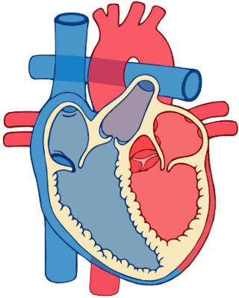
The heart has two separate sides, each with two chambers, giving four chambers in total.
The sides of the heart are the left and the right side. These are divided by a thick, muscular wall called a septum.
In this diagram, the left side of the heart is shown in red and the right side of the heart is shown in blue. That seems back to front though, right? The next slide will explain why!

Slide 9
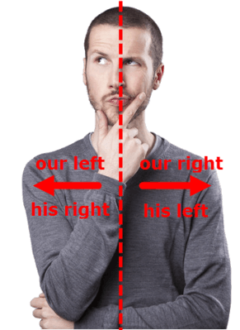
On the following diagrams the labels might look backwards, because what is on the left of the picture to us is labelled as being on the right.
What you have to imagine is that you're looking straight on at someone's chest, so your left is actually their right, and vice versa.

Slide 10
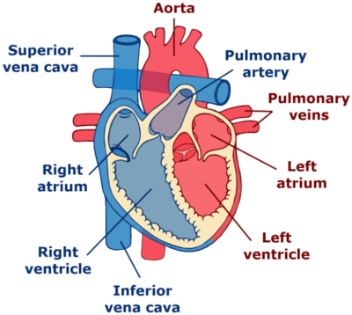
On each side of the heart, there are two chambers. These are called an atrium and a ventricle.
Both the left and right atria (singular: atrium) are the receiving chambers of the heart.
Blood coming into the heart from veins in the body or lungs enters in the left or right atrium.

Slide 11
Once blood enters the heart in either of the atria, it is then pushed into the ventricle on the same side of the heart as the atrium it came from.
Each atrium is separated from its ventricle by a valve. This prevents blood flowing backwards through the heart.

Slide 12
Ventricles
The ventricles contract to pump blood into the arteries, to travel to either the lungs or around the body.

Slide 13
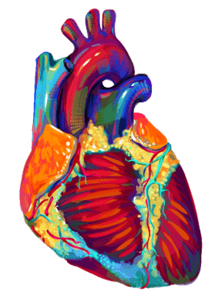
Our heart circulates our blood to two places:
1. | The lungs, to receive oxygen (become oxygenated).
2. | The body, where cells can use the oxygen (become deoxygenated).
All throughout the circulatory system, nutrients and wastes, such as carbon dioxide produced in cellular respiration, are transported via the blood.

Slide 14
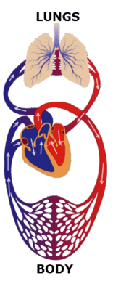
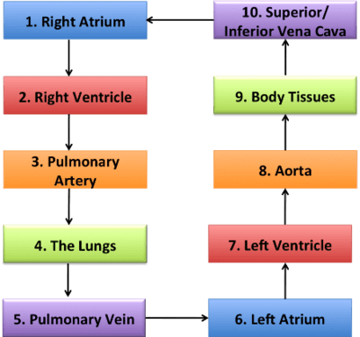
Below are two visual representations of the circulatory system and the pathway blood takes from start to finish.
You are about to learn this pathway in detail!

Slide 15
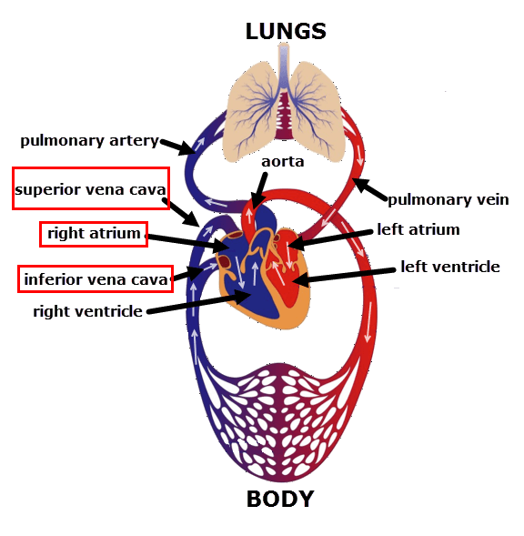
From the body, deoxygenated blood enters the heart through two big veins: the superior and inferior vena cava.
They both empty into the right atrium.

Slide 16
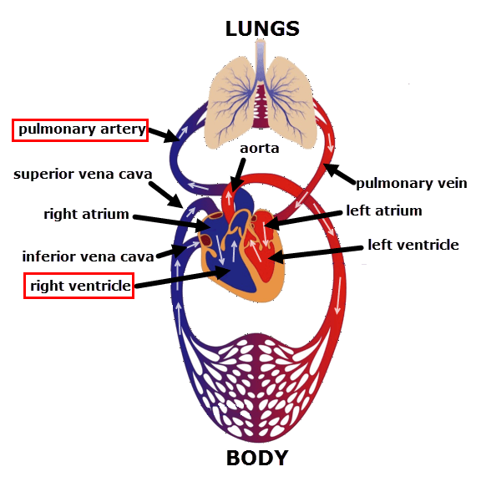
When the right atrium contracts, blood is pushed into the right ventricle.
The right ventricle then contracts, sending the blood into the pulmonary artery, where it heads to the lungs to become oxygenated.

Slide 17
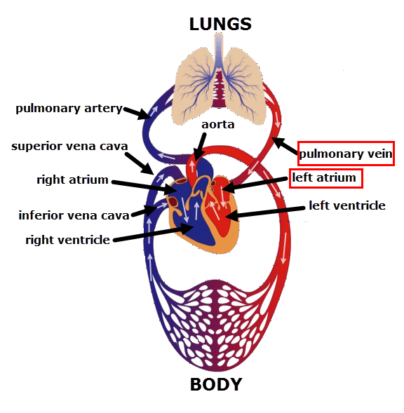
Once blood has passed through the lungs, it enters the pulmonary vein.
This drains into the left atrium.

Slide 18
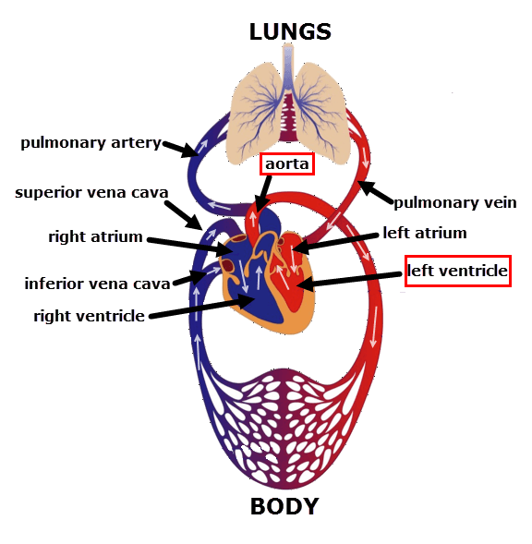
When the left atrium contracts, blood is pumped into the left ventricle.
The left ventricle then contracts and ejects blood into the aorta, the largest artery in our body!
The aorta then splits into smaller arteries, supplying all of our cells with oxygenated blood.

Slide 19
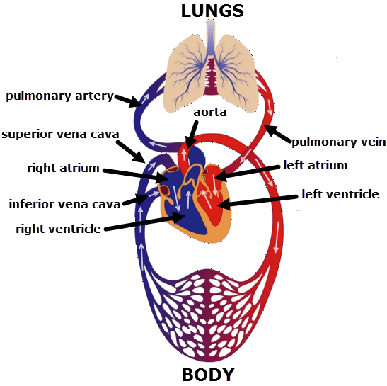
Once the cells have used up the oxygen they need from the blood, it then enters the veins
The blood from the veins (blood vessels that carry blood back to heart), eventually drain into the superior or inferior vena cava, to repeat its journey through the heart again!

Slide 20
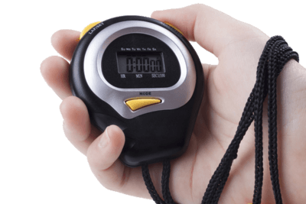
This process happens very quickly!
If a particular portion of blood starts in the inferior vena cava, it will circulate through the heart and around the lungs and body and back to where it started in just one minute!

Slide 21
